Slide 1
Symbioses
April 16, 2019

Slide 2
Ice-breaker questions
What is a symbiosis?
Why would a plant establish a symbiosis?
How would a scientist identify a symbiosis?
What are some examples of symbioses involving plants?

Slide 3
Today’s symbioses
Mycorrhizae
N-fixing bacteria
Fungal endophytes

Slide 4
Today’s symbioses
Mycorrhizae
N-fixing bacteria
Fungal endophytes

Slide 5
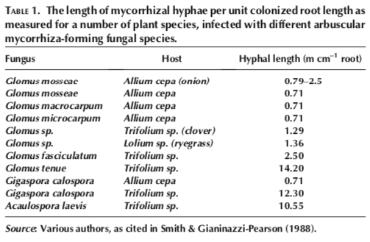
Mycorrhizae Basics
Associated with plant roots
82% of plant species
Increase root surface area
Similar to root hairs
Increase absorptive surface
Increases nutrient uptake
Primarily N and P

Slide 6
Types of Mycorrhizae
Arbuscular Mycorrhiza
Ectomycorrhiza
Ericoid Mycorrhiza
Orchid Mycorrhiza

Slide 7
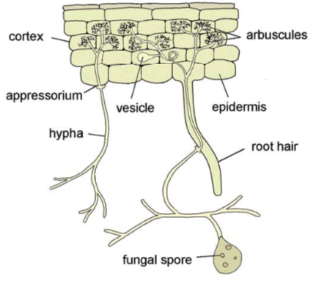
Arbuscular Mycorrhiza
Most widespread association
92% of all plant families
Trade nutrients for Carbon via arbuscules
Use vesicles for storage

Slide 8
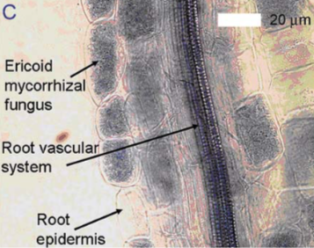
Ericoid Mycorrhiza
Restricted to bogs and heathlands in boreal areas
Heathers, bog berries, rhododendrons
Invade cells, but do not form arbuscules
Form coils instead

Slide 9
Orchid mycorrhiza
Specific to orchids
Provide entire carbon source during orchid seed development
Provide nutrients later in life
Penetrate cells

Slide 10
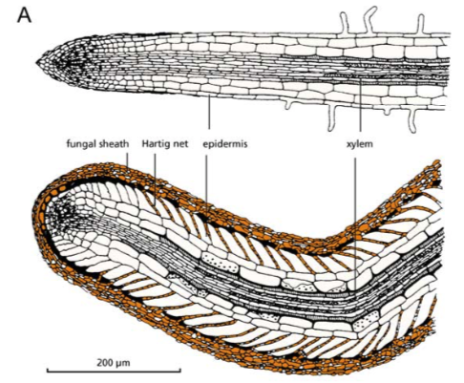
Ectomycorrhiza
Associations are more limited
Mainly trees: e.g., Pinus, Quercus, Salix, Fagus, Eucalyptus, Betula, Populus, Alnus, Fraxinus, Cupressus
Do not penetrate host cells
Exchange occurs in the intercellular spaces

Slide 11
Carbon costs of mycorrhizal symbioses

Slide 12
Effects of N & P on mycorrhizal symbioses

Slide 13
Today’s symbioses
Mycorrhizae
N-fixing bacteria
Fungal endophytes

Slide 14
Fabaceae

Slide 15
Nodule Forming Rhizobia

Slide 16
Carbon cost of the rhizobia symbiosis

Slide 17
Suppression of rhizobia symbiosis

Slide 18
Today’s symbioses
Mycorrhizae
N-fixing bacteria
Fungal endophytes

